Slide 2
Integration of Cucumber with Selenium and TestNG
Cucumber is a BDD Tool, and Selenium WebDriver is used for the automation of web applications. Imagine we need to build a test framework that can be used by businesses to understand the test scenarios and as well can test the web application. This can be achieved by integrating Cucumber with Selenium
This framework consists of:-
Cucumber Java- 7.6.0
Cucumber TestNG – 7.6.0
Java 11
TestNG – 7.4.0
Maven – 3.8.6
Selenium – 4.3.0

Slide 3
Table of Contents:
Implementation Steps
Download and Install Java
Download and setup Eclipse IDE on the system
Setup Maven
Install Cucumber Eclipse Plugin (Only for Eclipse IDE)
Download and install TestNG plugin
Create a new Maven Project
Create source folder src/test/resources to create test scenarios in Feature file
Add Selenium, TestNG, and Cucumber dependencies to the project
Add Maven Compiler Plugin and SureFire Plugin
Create a feature file (LoginPage.feature) containing all the test scenarios under src/test/resources/features
Create the step definition class in src/test/java
Create a TestNG Cucumber Runner class in src/test/java
Test Execution through TestNG
Run the tests from TestNG.xml
Run the tests from Command Line
Cucumber Report Generation
TestNG Report Generation

Slide 4
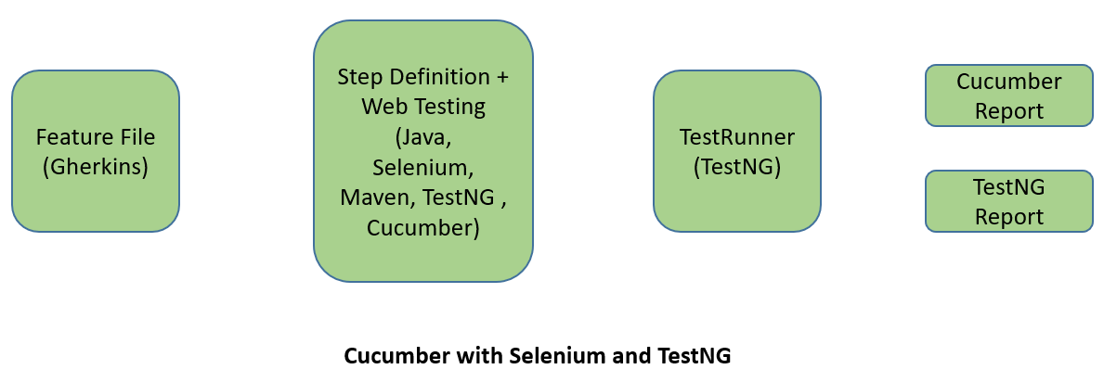

Slide 5
Implementation Steps
Step 1- Download and Install Java
Step 2 – Download and setup Eclipse IDE on the system
Step 3 – Setup Maven
Step 4 – Install Cucumber Eclipse Plugin (Only for Eclipse IDE)
How to install Cucumber Eclipse Plugin
The Cucumber plugin is an Eclipse plugin that allows eclipse to understand the Gherkin syntax. When we are working with cucumber we will write the feature files that contain Feature, Scenario, Given, When, Then, And, But, Tags, Scenario Outline, and Examples. By default, eclipse doesn’t understand these keywords, so it doesn’t show any syntax highlighter. Cucumber Eclipse Plugin highlights the keywords present in Feature File.

Slide 6
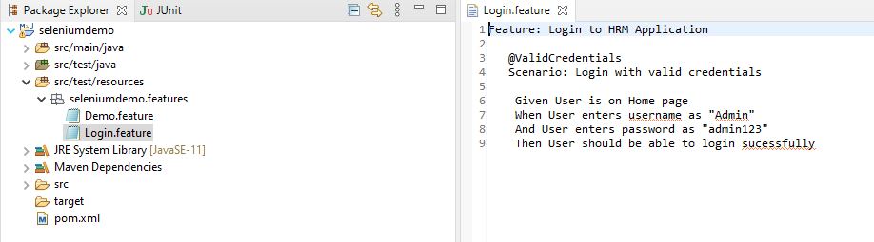
When we create a feature file in Eclipse it looks something like the below without Cucumber Eclipse Plugin installed.
It is easy to install Cucumber Eclipse Plugin, as it comes as a plugin for Eclipse IDE. A prerequisite for installing this plugin is your Internet connection should be up & running during the installation of this plugin and Eclipse IDE should be installed on your computer.

Slide 7
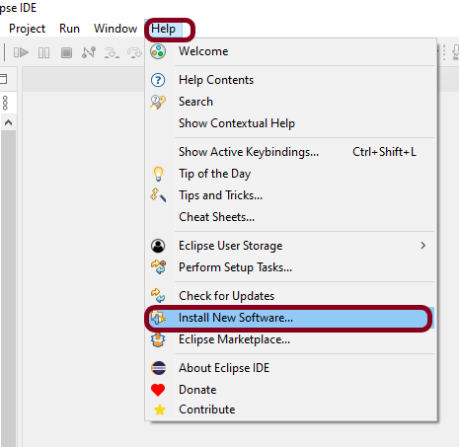
Steps to follow:
Step 1 – Launch the Eclipse IDE and, from the Help menu, click “Install New Software”.
Step 2 – You will see a dialog window, click the “Add” button.

Slide 8
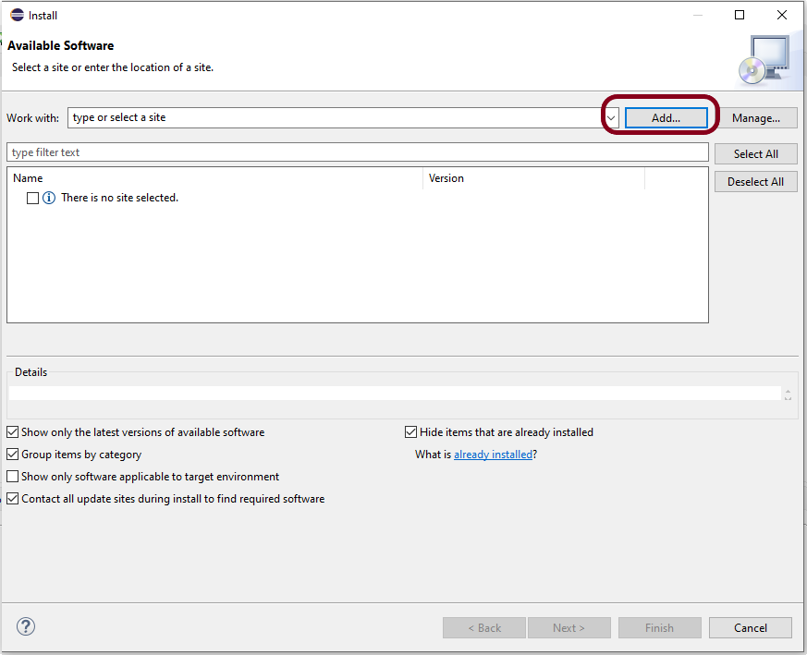
Step 3 – Type the name as you wish, let’s take “Cucumber” and type “https://cucumber.github.io/cucumber-eclipse-update-site-snapshot” as the location. Click the OK button.

Slide 9
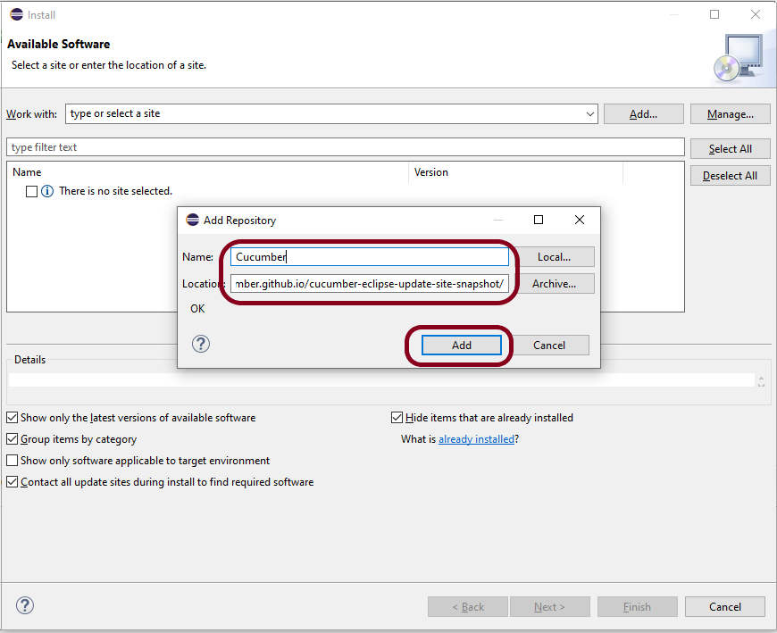
Step 4 – You come back to the previous window, but this time you must see the Cucumber Eclipse Plugin option in the available software list. Just check the box and press the “Next” button.

Slide 10
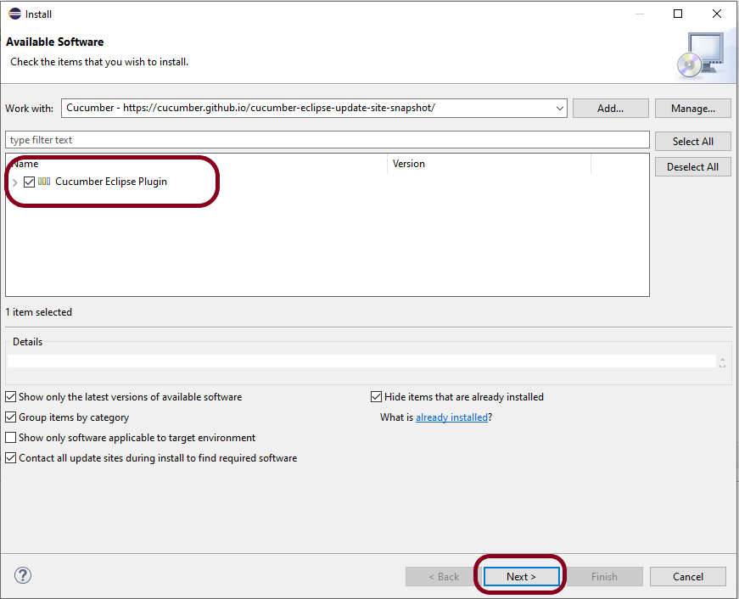

Slide 11
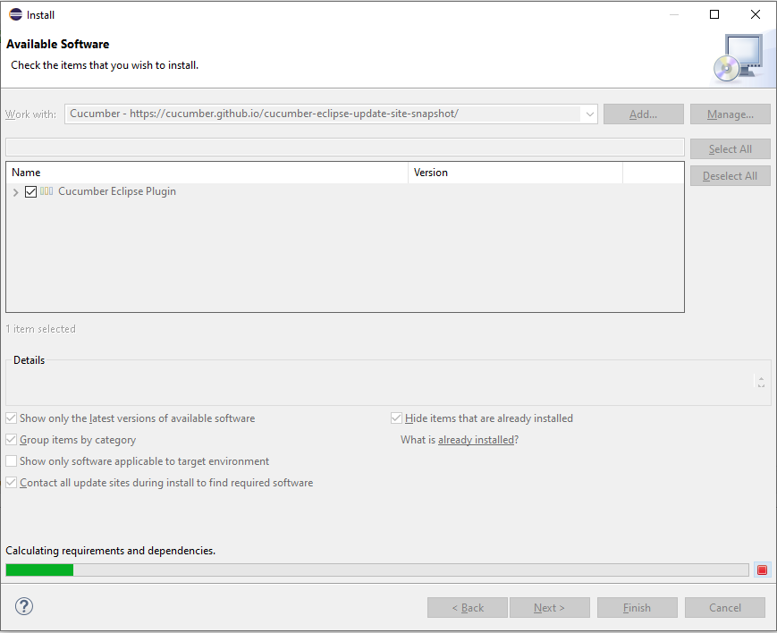
Step 5 – Click on the Next Button.

Slide 12
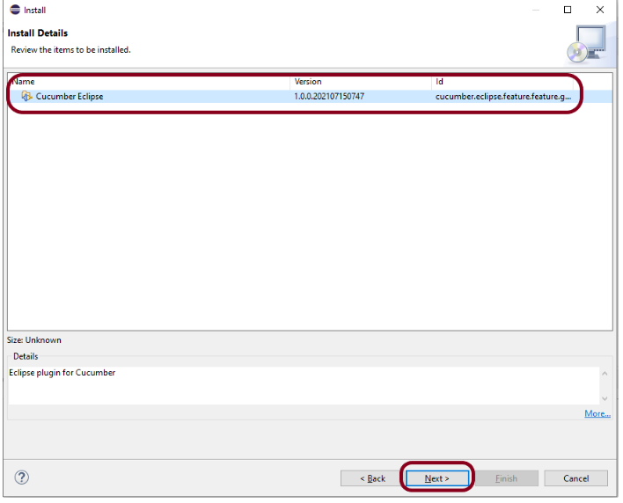
Step 6 – Click “I accept the terms of the license agreement” and then click the Finish button.

Slide 13
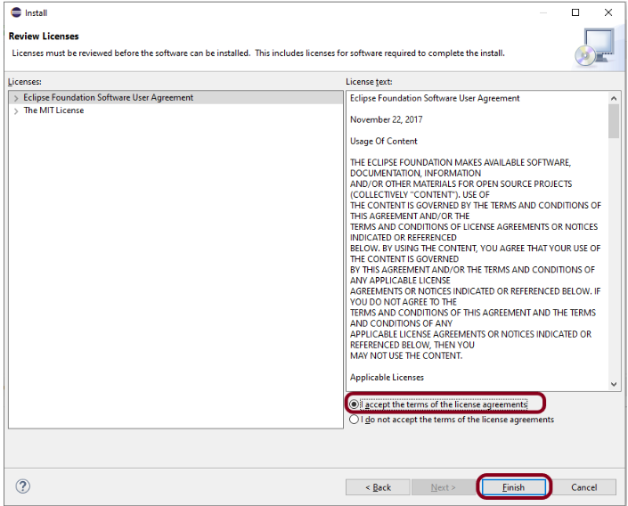
Step 7 – You may or may not encounter a Security warning, if in case you do just click the OK button.

Slide 14
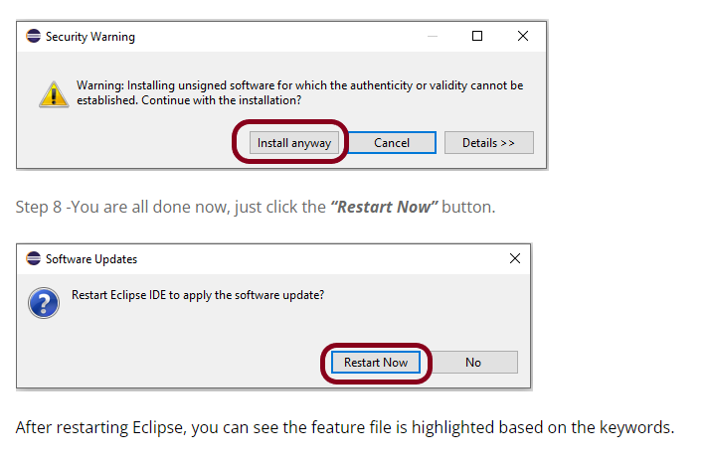
This means now Eclipse is able to understand the language we have written in the feature file as Gherkin language.

Slide 15
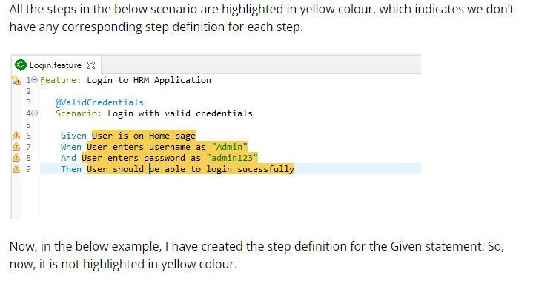

Slide 16
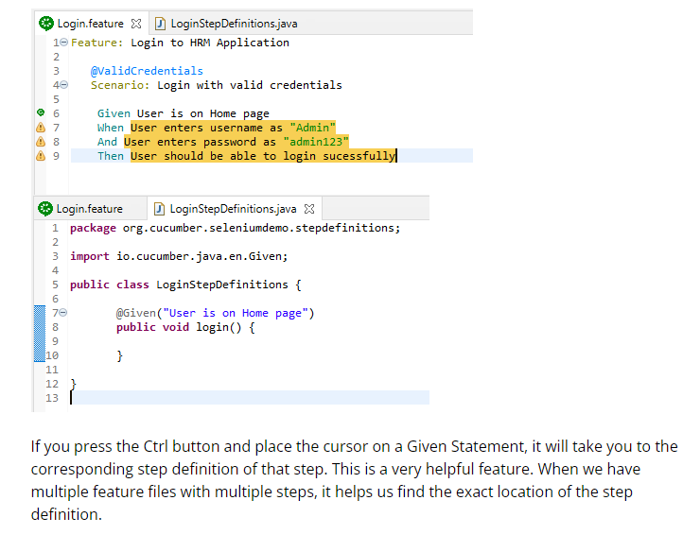

Slide 17
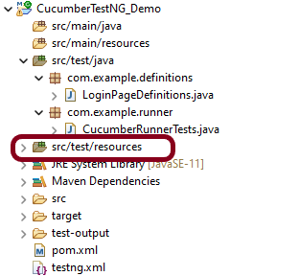
Step 5 – Download and install TestNG plugin
Step 6 – Create a new Maven Project
Step 7 – Create source folder src/test/resources to create test scenarios in Feature file
When a new Maven Project is created, it has 2 folders – src/main/java and src/test/java as shown below image. To create test scenarios, we need a new source folder called – src/test/resources. To create this folder, right-click on your maven project ->select New ->Java, and then Source Folder.

Slide 18
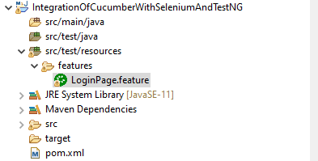
Step 8 – Add Selenium, TestNG, and Cucumber dependencies to the project
Step 9 – Add Maven Compiler Plugin and SureFire Plugin
The compiler plugin is used to compile the source code of a Maven project. This plugin has two goals, which are already bound to specific phases of the default lifecycle:
compile – compile main source files
testCompile – compile test source files
Step 10 – Create a feature file (LoginPage.feature) containing all the test scenarios under src/test/resources/features

Slide 19
It is recommended to create a features folder in src/test/resources directory. Create all the feature files in this features folder. Feature file should be saved as an extension of .feature. The test scenarios in the Feature file are written in Gherkins language
Step 11 – Create the step definition class in src/test/java
Create the step definition class corresponding to the feature file to test the scenarios in the src/test/java directory. The StepDefinition files should be created in this definitions directory within the folder called definitions.
Step 12 – Create a TestNG Cucumber Runner class in src/test/java
We need to create a class called Runner class to run the tests. This class will use the TestNG annotation @RunWith(), which tells TestNG what is the test runner class. TestRunner should be created under src/test/java within the folder called runner.

Slide 20
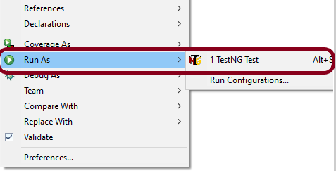
AbstractTestNGCucumberTests – Runs each cucumber scenario found in the features as a separate test.
Step 13 – Test Execution through TestNG
Go to the Runner class and right-click Run As TestNG Test. The tests will run as TestNG tests. This is for Eclipse.
In case you are using IntelliJ, then select “Run CucumberRunner Tests“.

Slide 21
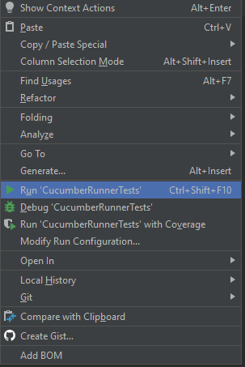
Note:- If the test execution fails with the below-shown error, that means you have Chrome Version 111 installed on your machine which is not compatible with Selenium Version 4.8.2 and below. Please refer to this tutorial to fix the issue – Selenium Tests failing on Chrome Version 111.
This is what the execution console will look like in Eclipse.

Slide 22
?????????????????????????????????????????????????????????????????????????????????????[0m
[32m[1m?[0m Share your Cucumber Report with your team at [36m[1m[4mhttps://reports.cucumber.io[0m [32m[1m?[0m
[32m[1m?[0m Activate publishing with one of the following: [32m[1m?[0m
[32m[1m?[0m [32m[1m?[0m
[32m[1m?[0m src/test/resources/cucumber.properties: [36mcucumber.publish.enabled[0m=[36mtrue[0m [32m[1m?[0m
[32m[1m?[0m src/test/resources/junit-platform.properties: [36mcucumber.publish.enabled[0m=[36mtrue[0m [32m[1m?[0m
PASSED: runScenario("Login with invalid credentials", "Login to sauceLabsDemo Application")
Runs Cucumber Scenarios
PASSED: runScenario("Login with invalid credentials", "Login to sauceLabsDemo Application")
Runs Cucumber Scenarios
PASSED: runScenario("Login with invalid credentials", "Login to sauceLabsDemo Application")
Runs Cucumber Scenarios
PASSED: runScenario("Login with valid credentials", "Login to sauceLabsDemo Application")
Runs Cucumber Scenarios
Step 14 – Run the tests from TestNG.xml

Slide 23
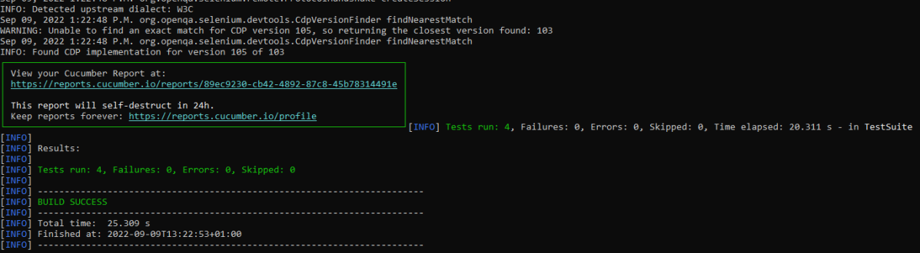
Step 15 – Run the tests from Command Line
Run the below command in the command prompt to run the tests and to get the test execution report.
 | mvn clean test

Slide 24
Step 16 – Cucumber Report Generation
Add cucumber.properties under src/test/resources and add the below instruction in the file.
cucumber.publish.enabled=true

Slide 25
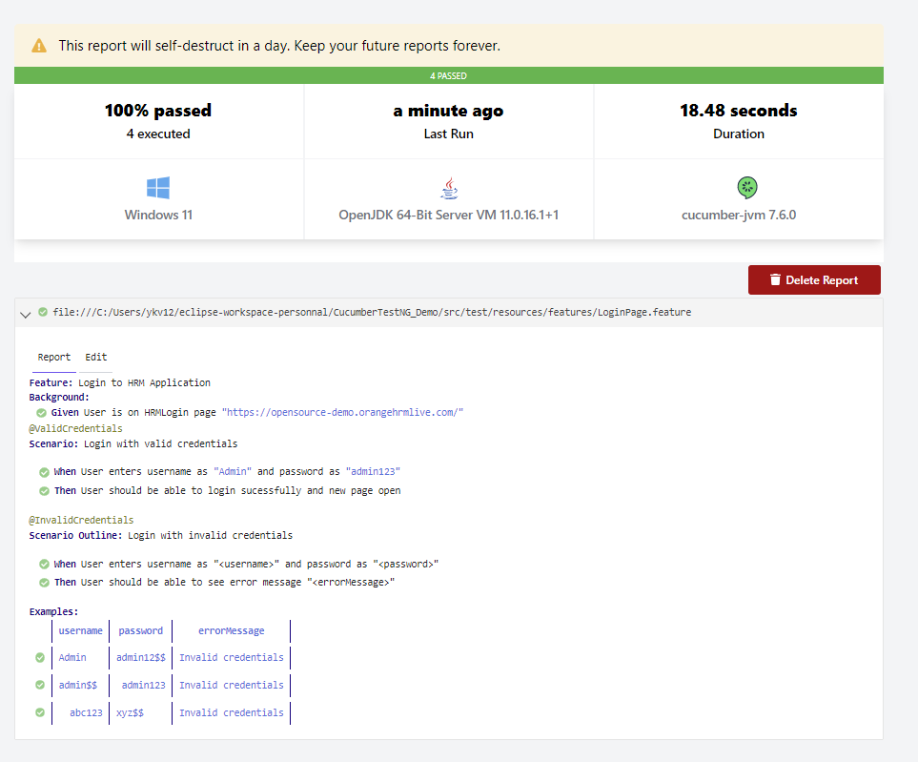
Step 17 – TestNG Report Generation

Slide 26
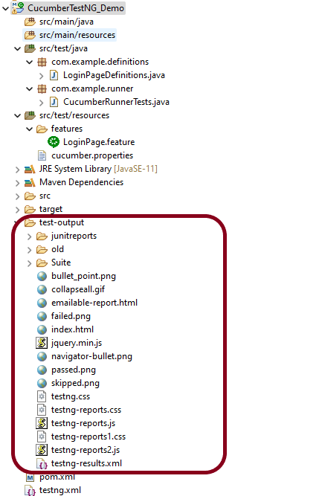
We are interested in the ‘emailable-report.html’ report. Open “emailable-report.html“, as this is an HTML report, and open it with the browser. The below image shows emailable-report.html.

Slide 27
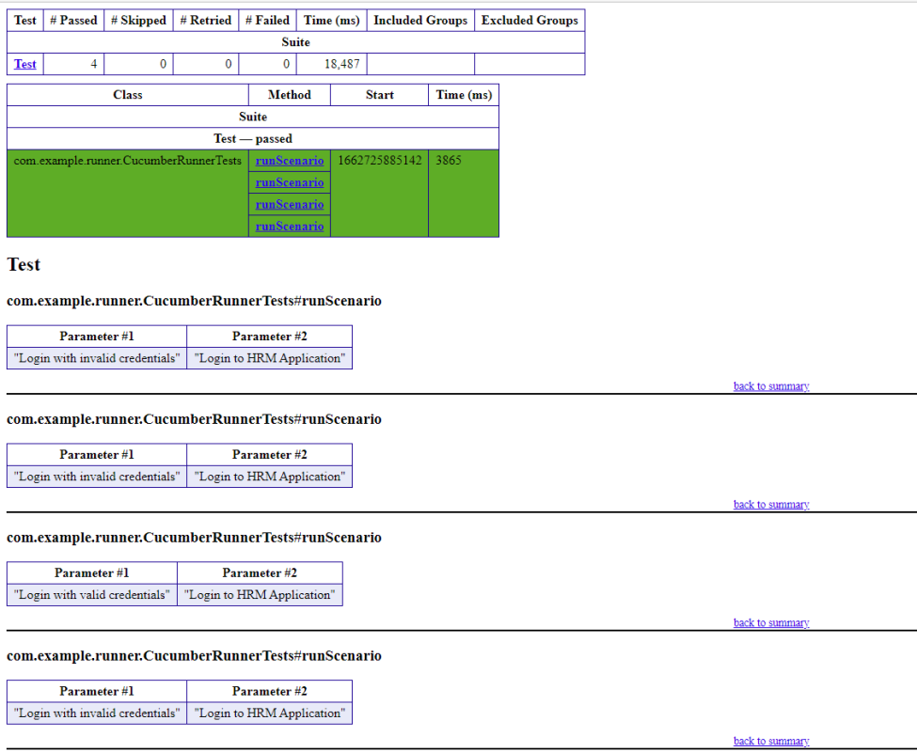

Slide 28
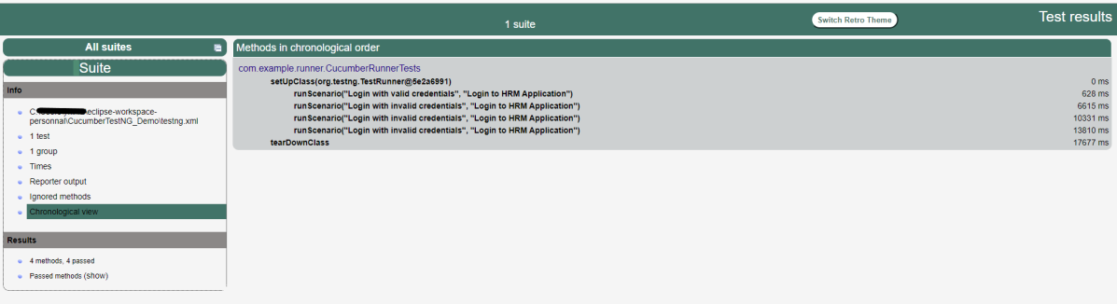
Index.html
TestNG also produce “index.html” report, and it resides under test-output folder. The below image shows the index.html report.
https://reports.cucumber.io/reports/cf6a725e-c1e8-4fb7-8d98-d54250d22df7

